Slide 1
Lecture 2.1: Wrapping up load prediction.
S. Bose, K. Alshehri
Electrical and Computer Engineering
University of Illinois at Urbana Champaign
ECE 398 BD: Making sense of big data.
Fall 2018.

Slide 2
Using neural networks + what you learned in Part 1, we will cover:
Lab 11: Patterns in load, load prediction, effects of renewable supply.
Lab 12: Power flow equations, sensor measurements and bad data detection.
Lab 13: Virtual trading in NYISO’s markets
Lab 14-15: As time permits:
Maintaining grid frequency
Making sense of smart meter data
Office hours: Fri 1-2pm. Email me if you need to meet outside of that.

Slide 3
Power Grid: Overview
source

Slide 4
Why predict load?
Operational paradigm of the power system:
Predict, schedule, balance
Closer to time of energy delivery
Automatic generation control
Primary frequency control
Day-ahead market
Real-time market
Load prediction allows you to ensure the availability of generators:
Ones with low ramping capabilities must be scheduled forward. Think nuclear.
Ones with high ramping capabilities should have fuel available. Think natural gas.

Slide 5
Independent System Operators
source
NYISO: http://www.nyiso.com/public/markets_operations/market_data/load_data/index.jsp
ERCOT: http://www.ercot.com/gridinfo/load/load_hist/
PJM: https://www.pjm.com/markets-and-operations/energy.aspx
ISONE: https://www.iso-ne.com/isoexpress/web/reports/load-and-demand
CAISO: http://www.caiso.com/TodaysOutlook/Pages/default.aspx
MISO: https://www.misoenergy.org/markets-and-operations/real-time-displays/

Slide 6
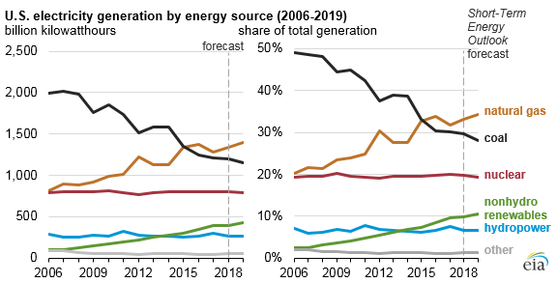
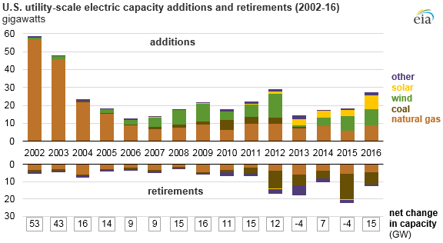
Changing resource mix of electricity generation
Electricity generation by source
Utility-scale
Utility-scale annual additions to generation capacity by source
27GW capacity addition in 2016
Wind = 8.7 GW,
Solar = 7.7 GW,
Natural gas = 9 GW.
Distributed (rooftop) solar = 3.4GW
An excellent source of data: Energy Information Administration https://www.eia.gov/

Slide 7
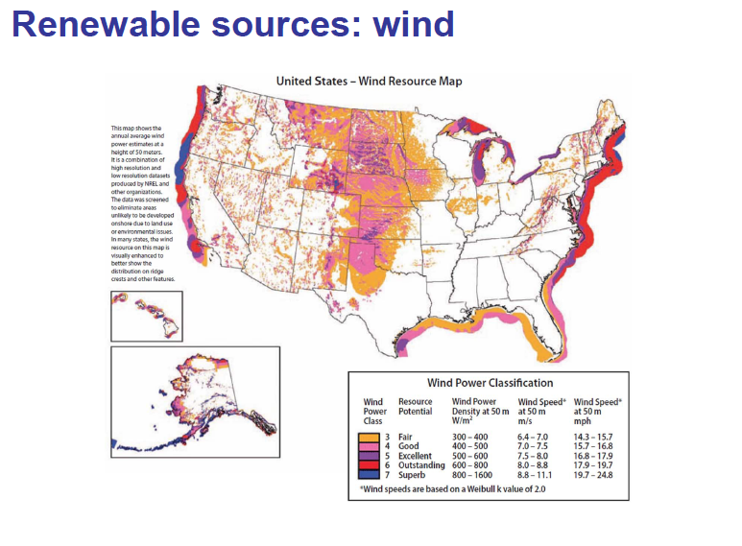
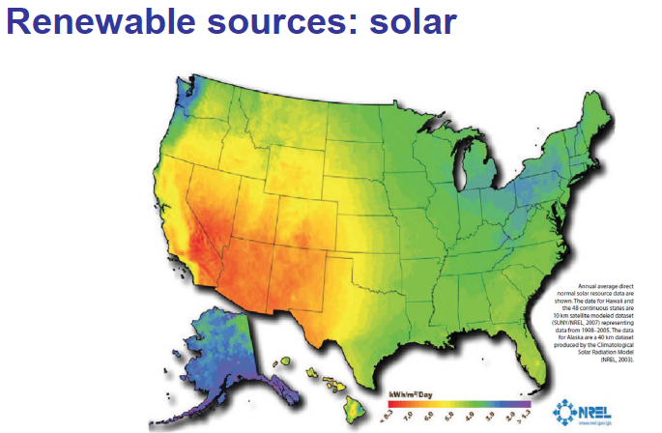
Integrating VRE in transmission systems (Images from NREL, Wikipedia)

Slide 8
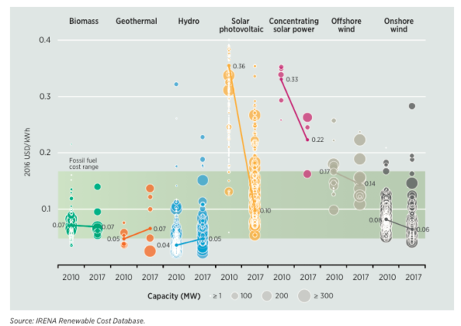

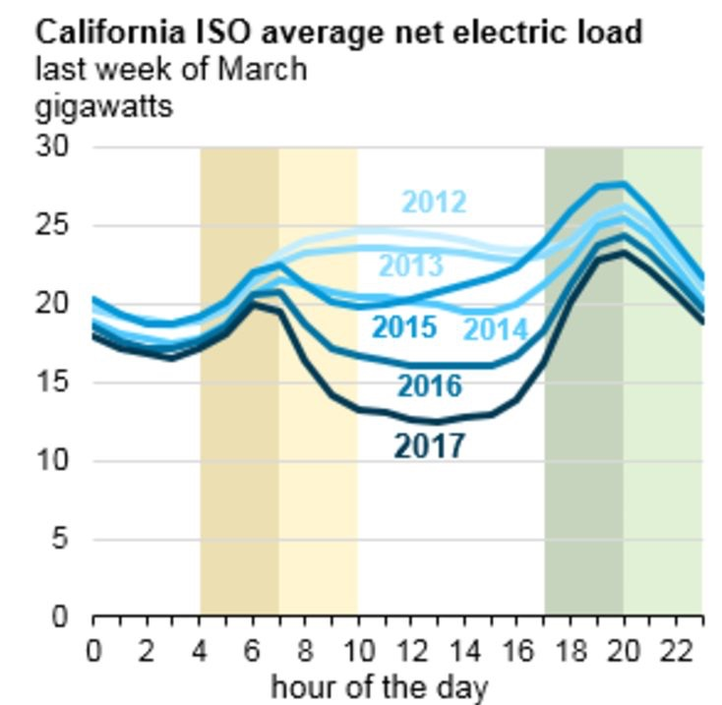

Rapid adoption of wind and solar
27GW utility scale capacity addition in 2016:
Wind = 8.7 GW, Solar = 7.7 GW, Natural gas = 9 GW.
+ Distributed (rooftop) solar = 3.4GW

Slide 9
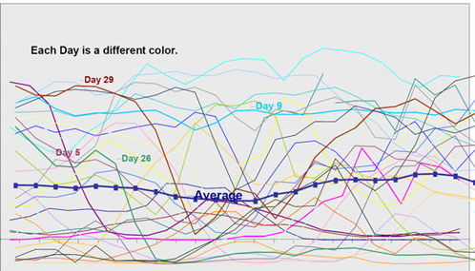
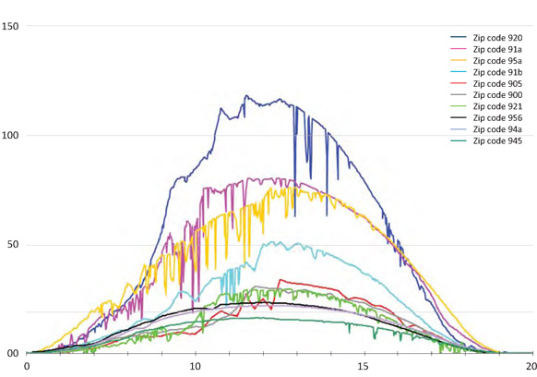
Variable renewable energy (VRE)
Uncertain: difficult to forecast in advance
Intermittent: exhibits unpredictable ramps
Non-dispatchable: output is largely uncontrollable
Wind generation
Solar generation
Power
Time of day
Time of day

Slide 10
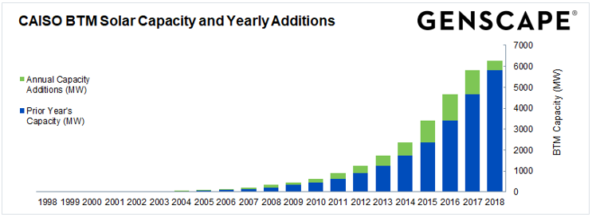
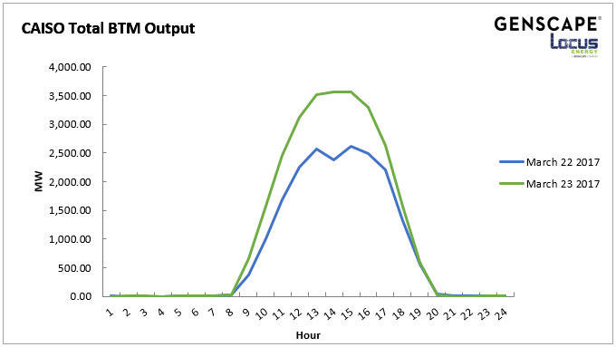
Predict, schedule, balance
Closer to time of energy delivery
Automatic generation control
Primary frequency control
Day-ahead market
Real-time market
Fessenden ‘18
Load v/s net load
Net demand = Demand – Renewable supply
Created using load data from NYISO and synthetic wind data from NREL.

Slide 11
Look at current operating conditions
Some ISOs already offer visualizations of their operating conditions:
ERCOT:
http://www.ercot.com/content/cdr/html/CURRENT_DAYCOP_HSL.html?uniquenessFactor=1541692881440
CAISO:
http://www.caiso.com/TodaysOutlook/Pages/default.aspx
Items to pay attention to:
Difference between day-ahead and real-time wind prediction in Texas.
Net demand versus demand in California

